Slide 1
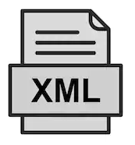

Spring Boot - Building Restful Web Services With Jersey + JPA
Postman client
SpringBootDemo
DB
Consuming a RESTful
Web Services by using Postman client
REST API end points to Create/Update/Get/delete/Get list of Employee details

Slide 2
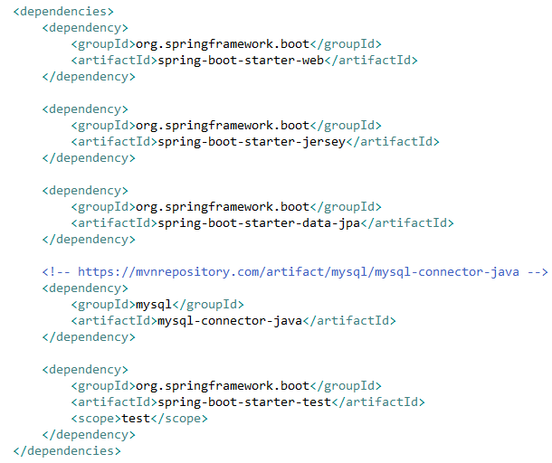
Spring Boot - Building Restful Web Services With Jersey + JPA

Slide 3
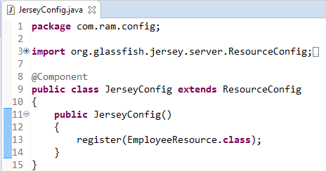
Spring Boot - Building Restful Web Services With Jersey + JPA
Now we have a JAX-RS resource and we want to access it from spring boot application which include Jersey dependency. Let’s register this resource as Jersey resource.
Look at the @Component annotation. It enables this class to be registered while spring boot auto scans the java classes in source folder.
ResourceConfig provides advanced capabilities to simplify registration of JAX-RS components.

